Slide 2
CHAPTER 4: IMPERFECTIONS IN SOLIDS
ISSUES TO ADDRESS...
• What are the solidification mechanisms?
• What types of defects arise in solids?
• Can the number and type of defects be varied
and controlled?
• How do defects affect material properties?
• Are defects undesirable?
<number>
Notes:
<number>

Slide 3
Imperfections in Solids
Many of the important properties of materials are due to the presence of imperfections, or defects. Anything that disrupts the symmetry of the material is by definition a defect. Defects in materials are not necessarily bad.
What are these imperfections?
Why are they important?
<number>
Notes:
<number>

Slide 4
Types of Imperfections in Crystals
Vacancy atoms
Interstitial atoms
Substitutional atoms
Point defects
Dislocations
Line defects
Grain Boundaries
Surfaces
Area defects
<number>
Notes:
<number>

Slide 5
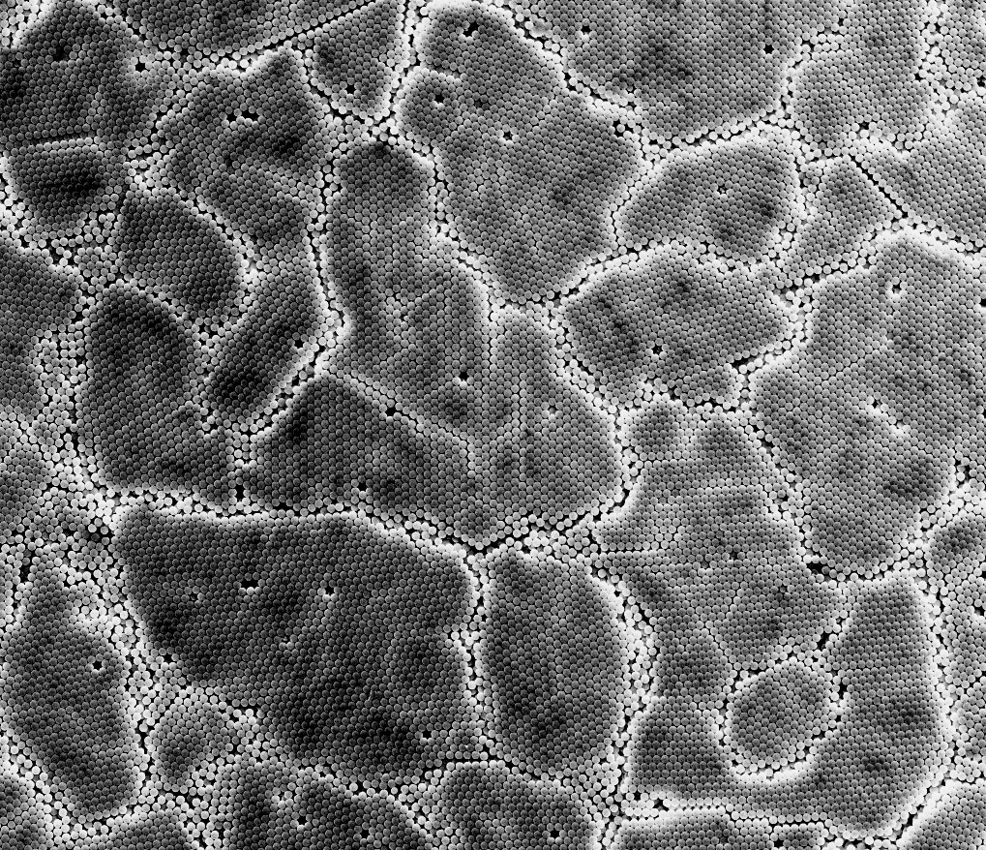
<number>

Slide 6
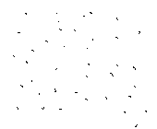
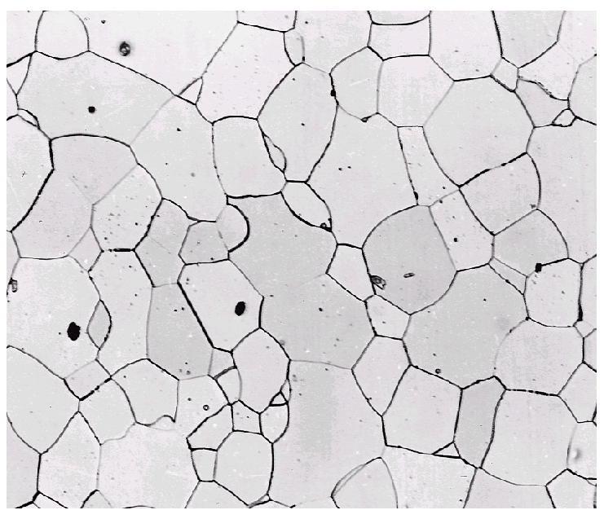
Imperfections in Solids
Solidification- result of casting of molten material
2 steps
Nuclei form
Nuclei grow to form crystals – grain structure
Start with a molten material – all liquid
nuclei
crystals growing
grain structure
liquid
Crystals grow until they meet each other
<number>
Notes:
<number>

Slide 7
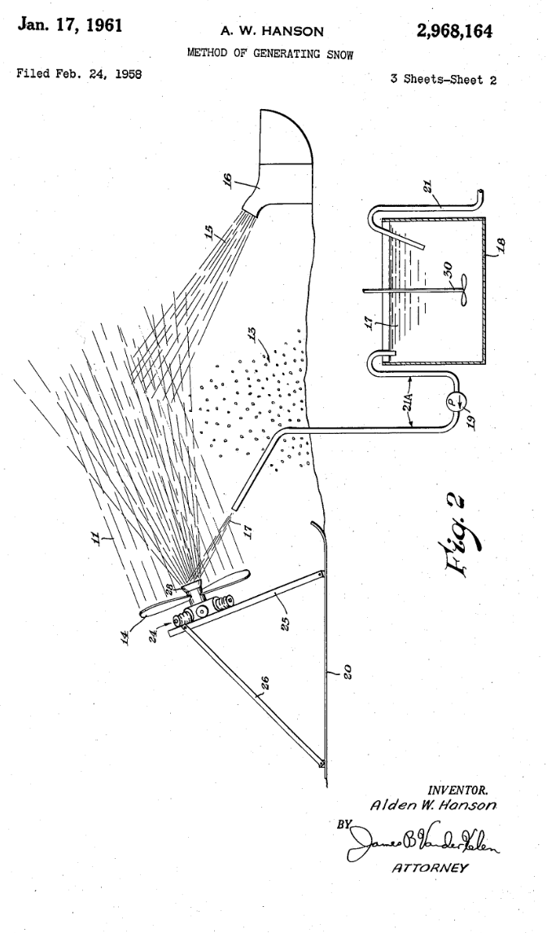
Nucleating Agents: Water -> Snow
“Surprisingly, the use of dirty water or water containing crushed ice results in more efficient operation, whereby the dirt and ice particles serve as crystallizing nuclei thereby aiding in the formation of snow crystals.”
<number>

Slide 8

Crystal Nucleating Agents
<number>

Slide 9
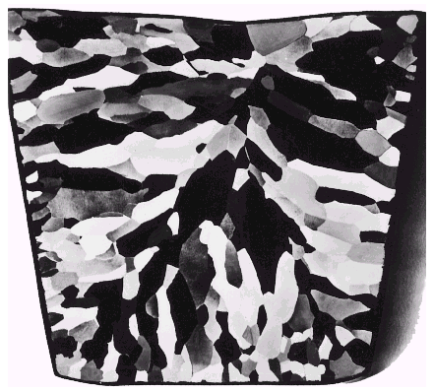
Solidification
Grains can be - equiaxed (roughly same size in all directions)
- columnar (elongated grains)
~ 8 cm
heat
flow
Shell of equiaxed grains due to rapid cooling (greater ΔT) near wall
Columnar in area with less undercooling
Grain refiner - added to make smaller, more uniform, equiaxed grains.
<number>
Notes:
<number>

Slide 10
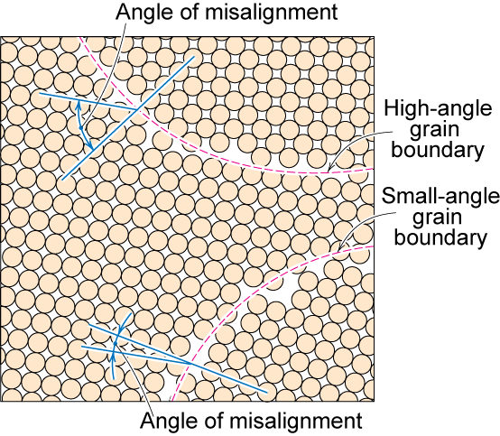
Polycrystalline Materials
Grain Boundaries
regions between crystals
transition from lattice of one region to that of the other
slightly disordered
low density in grain boundaries
high mobility
high diffusivity
high chemical reactivity
<number>
Notes:
<number>

Slide 11
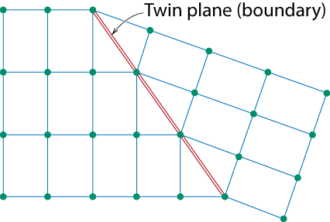
Planar Defects in Solids
One case is a twin boundary (plane)
Essentially a reflection of atom positions across the twin plane.
Stacking faults
For FCC metals an error in ABCABC packing sequence
Ex: ABCABABC
<number>
Notes:
<number>

Slide 12
Point Defects
<number>

Slide 13
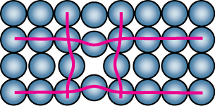
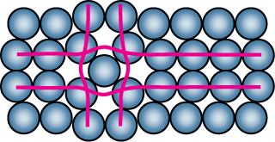
Point Defects
• Vacancies:
-vacant atomic sites in a structure.
Vacancy
distortion
of planes
• Self-Interstitials:
-"extra" atoms positioned between atomic sites.
self-
interstitial
distortion
of planes
<number>
Notes:
<number>

Slide 14
Point Defects in Ionic Crystals
<number>

Slide 15
Importance of point defects
Solid-state diffusion (Chapter 5)
Mechanical properties (carbon in iron)
Electrical properties in semiconductors
Color
Al₂O₃: alumina, corundum (trigonal crystal structure)
+Chromium → ruby (red)
+Titanium, Iron,… → sapphire (not red: blue, orange, …)
<number>

Slide 16
Equilibrium Concentration: Point Defects
• Equilibrium concentration varies with temperature
No. of defects
Activation energy
⎛
−
⎞
N
v
⎜
Q
v
=
exp
⎜
No. of potential
⎝
⎠
N
k
T
defect sites.
Temperature
Boltzmann's constant
(1.38 x 10
-23
J/atom-K)
(8.62
x
10
-5
eV/atom-K)
Each lattice site
is a potential
vacancy site
<number>
Notes:
<number>

Slide 17
Measuring Activation Energy
⎛
−
⎞
• We can get Q_{v} from
an experiment.
N
v
⎜
Q
v
=
exp
⎜
N
⎝
k
T
⎠
• Measure this...
• Replot it...
N
v
N
slope
v
ln
N
N
-
Q
v
/k
exponential
dependence!
T
1/
T
defect concentration
<number>
Notes:
<number>

Slide 18
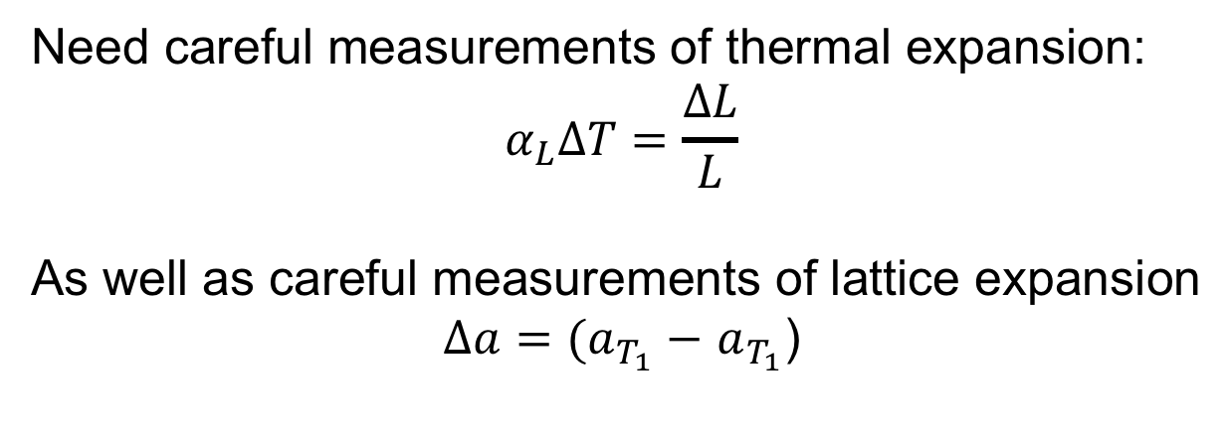
Q: how is N_{v} actually measured?
Need careful measurements of thermal expansion:
As well as careful measurements of lattice expansion
)
(dilatometry)
(X-ray diffraction)
Effect is small (Nv low relative to N), so experiments
require accuracy of 1/100,000, must be done at same time
Simmons and Balluffi, Phys. Rev., 117, 52, (1960).
<number>

Slide 19
Estimating Vacancy Concentration
• Find the equil. # of vacancies in 1 m³ of Cu at 1000°C.
• Given:
ρ
= 8.4 g
/
cm
3
A
= 63.5 g/mol
Cu
Q
v
= 0.9 eV/atom
N
A
= 6.02 x 10²³
atoms/mol
0.9 eV/atom
⎛
−
⎞
N
v
⎜
Q
v
=
exp
⎜
= 2.7 x 10⁻⁴
N
⎝
k
T
⎠
1273K
8.62 x 10⁻⁵
eV/atom-K
N
A
For 1 m³
, N =
ρ
x
x
1 m³
= 8.0 x 10²⁸ sites
A
Cu
• Answer:
N
v
=
(2.7 x 10⁻⁴)(8.0 x 10²⁸) sites = 2.2 x 10²⁵ vacancies
<number>
Notes:
<number>

Slide 20
Point Defects in Alloys
Two outcomes if impurity (B) added to host (A):
• Solid solution of B in A (i.e., random dist. of point defects)
OR
Substitutional solid soln.
(e.g., Cu in Ni)
Interstitial solid soln.
(e.g., C in Fe)
• Solid solution of B in A plus particles of a new
phase (usually for a larger amount of B)
Second phase particle
--different composition
--often different structure.
<number>
Notes:
<number>

Slide 21
Imperfections in Solids
Specification of composition
weight percent
m₁ = mass of component 1
atom percent
n_{m1} = number of moles of component 1
volume percent
V_{m1} = volume of component 1 = m₁/ρ₁
<number>
Notes:
<number>

Slide 22
Line Defects
Dislocations:
• are line defects,
• slip between crystal planes result when dislocations move,
• produce permanent (plastic) deformation.
Schematic of Zinc (HCP):
• before deformation
• after tensile elongation
slip steps
<number>
Notes:
<number>

Slide 23
Imperfections in Solids
Linear Defects (Dislocations)
Are one-dimensional defects around which atoms are misaligned
Edge dislocation:
extra half-plane of atoms inserted in a crystal structure
b ⊥ to dislocation line
Screw dislocation:
spiral planar ramp resulting from shear deformation
b || to dislocation line
Burger’s vector, b: measure of lattice distortion
<number>
Notes:
<number>

Slide 24
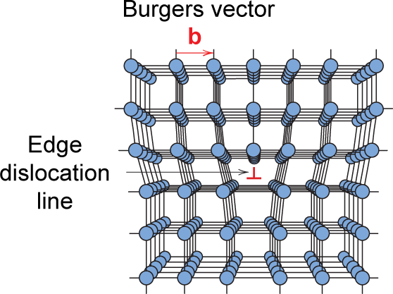
Imperfections in Solids
Edge Dislocation
<number>
Notes:
<number>

Slide 25
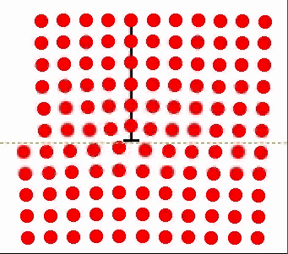
Motion of Edge Dislocation
• Dislocation motion requires the successive bumping
of a half plane of atoms (from left to right here).
• Bonds across the slipping planes are broken and
remade in succession.
Atomic view of edge
dislocation motion from
left to right as a crystal
is sheared.
<number>
Notes:
<number>

Slide 26
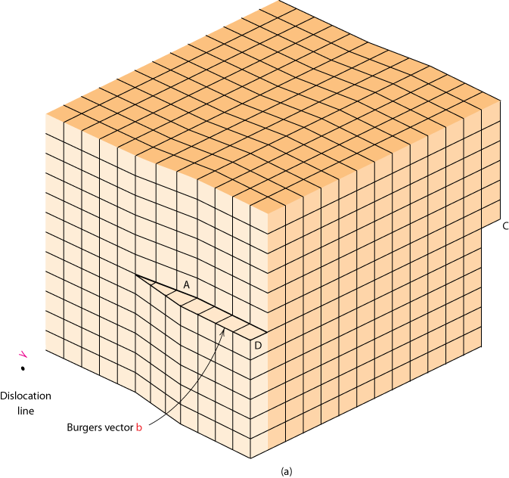
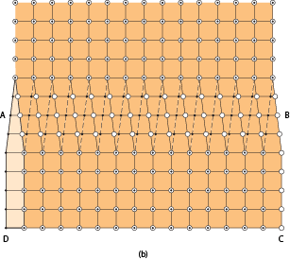
Imperfections in Solids
Screw Dislocation
Screw Dislocation
Dislocation
line
b
Burgers vector b
(b)
(a)
<number>
Notes:
<number>

Slide 27
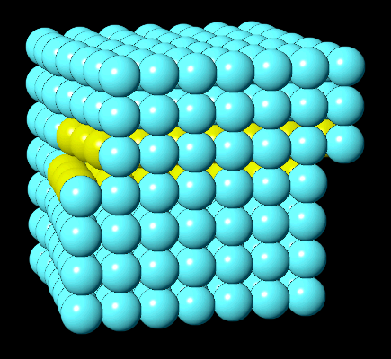
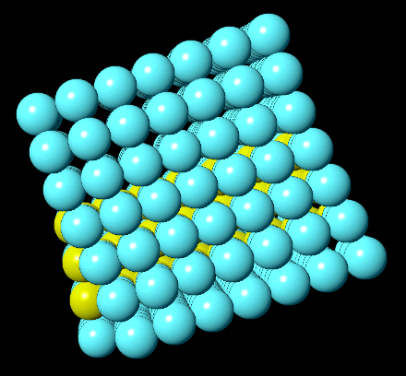
Screw Dislocation
In VMSE on wileyplus:
a region of crystal containing a dislocation can be rotated in 3D
dislocation motion may be animated
Front View
Top View
VMSE Screen Shots
<number>
Notes:
<number>

Slide 28
Edge, Screw, and Mixed Dislocations
Mixed
Edge
Screw
<number>
Notes:
<number>

Slide 29
Screw Dislocation Motion in CaO
Paulo Branicio, USC
https://youtu.be/JPVS8d2c_4U
Dislocations can
dissociate into
two partials and
a stacking fault
Needle in particles:
https://youtu.be/VLsLS74AM9o
Bragg, 1947, bubbles:
https://youtu.be/1r-UqxmuYCw
<number>

Slide 30
Why dissociate into partials?
Dislocation energy is proportional to Gb²
Full dislocation → Two partials + stacking fault
Gb² → G(b/2)² + γf + G(b/2)²
If equal, f = Gb²/2γ or γ = Gb²/2f
If γ small, partials will separate widely (f large)
<number>

Slide 31
Surface Energy
Some values of surface energy: mN/m or dyn/cm
Substance | Surface tension
Hexane | 18.4
Ethanol | 22.3
Acetic acid | 27.6
Water | 72
Mercury | 487
Carbon | 3700
Hexane

